Slide 1
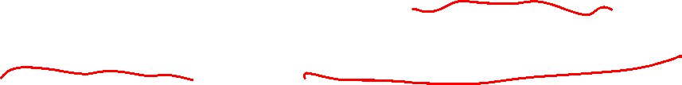
Section 7.4 Integration of Rational Functions By Partial Fractions
Lecture 1
Idea of PFD: Reversing Fraction Addition

Slide 2

Section 7.4 Homework Submission to Canvas
Preview of section
Skim the section in text and write a short paragraph summary.
Give a bulleted list of all important definitions, theorems, and formulas without details.
Notes on video lectures
Take notes on everything written on slides including all details, worked examples, on-own activities, as well as your own thoughts and questions.
Try on-own activities first, then write down provided solution next to it for comparison.
Worked examples from the text
Write down the problem and attempt without looking at the solution.
Use the solution to write the best explanation you can.
Solutions to textbook exercises
Model approaches and explanations given in the video lectures and textbook examples.
Final reflection of section
List the key takeaways to remember as a bulleted list.

Slide 3
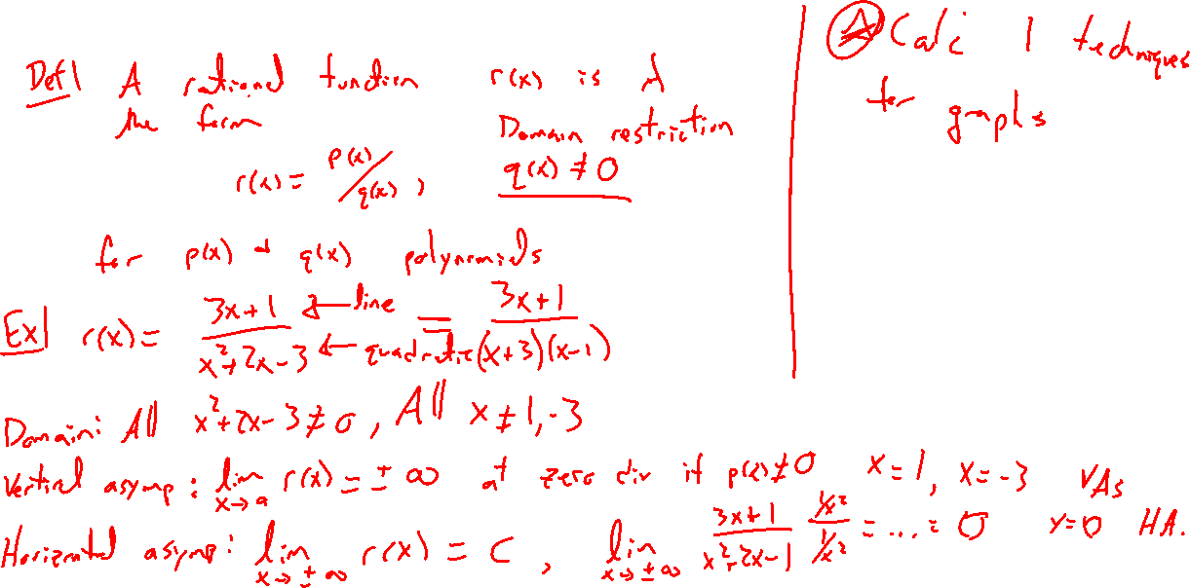
Rational Function Review
Notes:
Def: r(x) = p(x)/q(x), for p,q polynomials, domain
Ex: (3x+1)/(x^2+2x-3) = (3x+1)/[(x-1)(x+3)]
Vertical and horizontal asymptotes. Desmos.

Slide 4
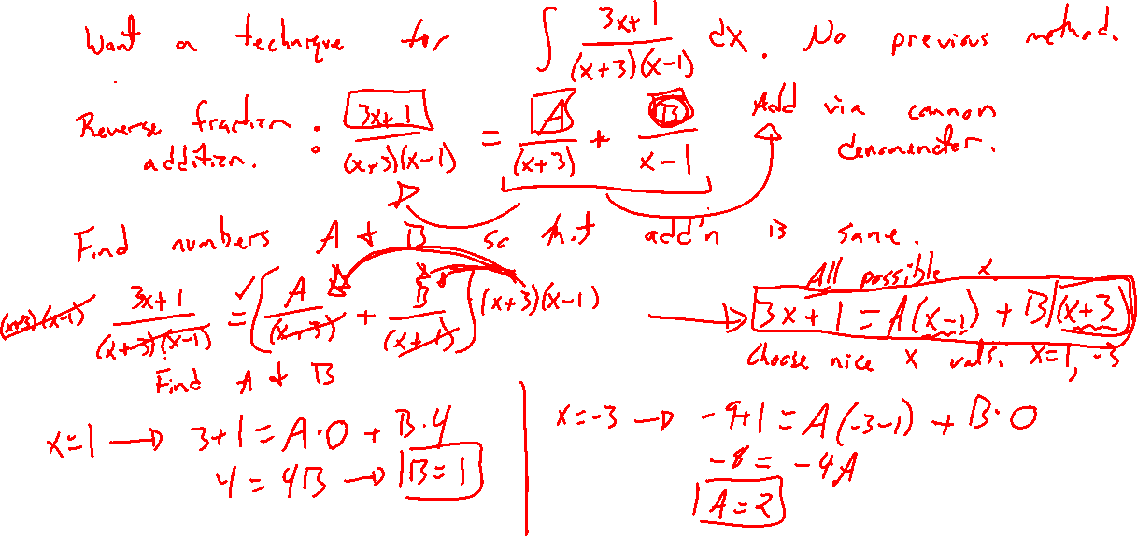
Example: Decomposing Rational Functions
Notes:
Ex: Integrating (3x+1)/(x^2+2x-3) = (3x+1)/[(x-1)(x+3)]
How to reverse fraction addition? Integration is now easy.
Note: Decomposition is easy to check.
Warning: Definite integral bounds cannot contain an asymptote. 7.8 covers this weirdness.

Slide 5
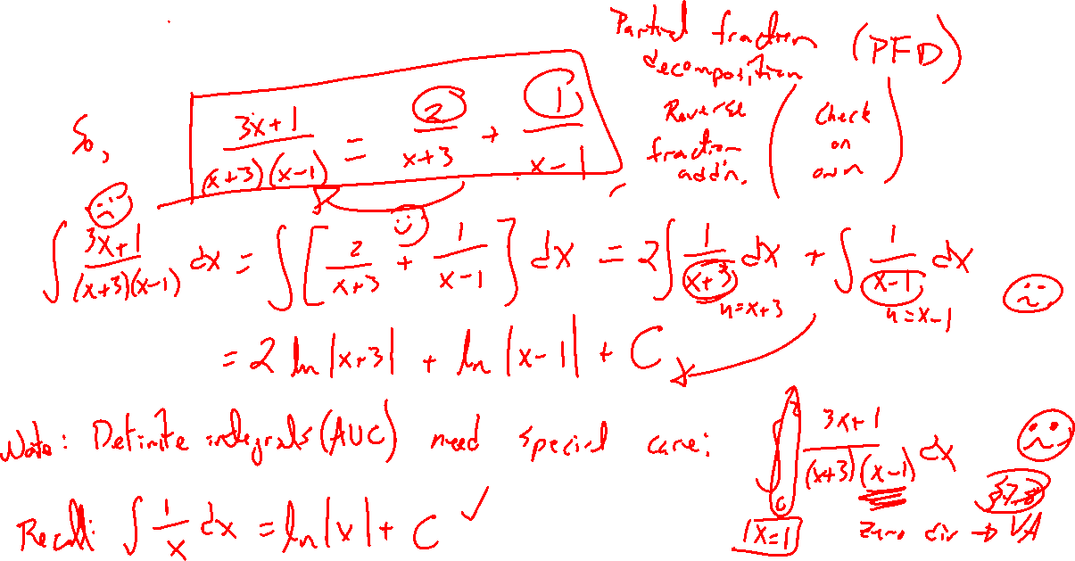
Example: Continued

Slide 6
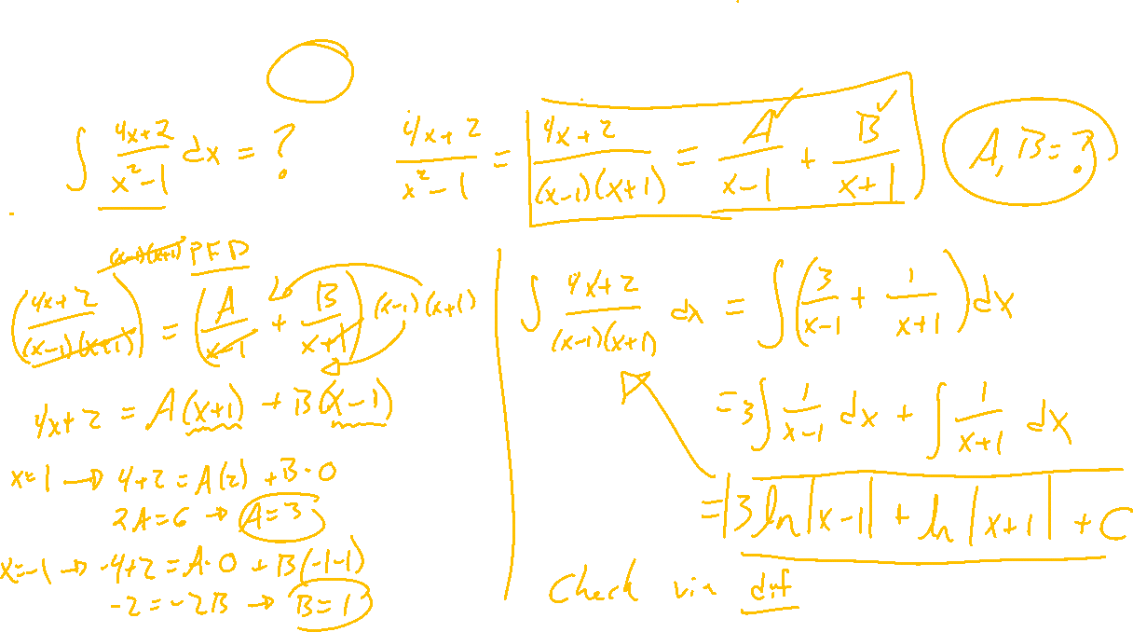
Example: Try on Own
Notes:
Ex: (4x-2)/(x^2-1)

Slide 7
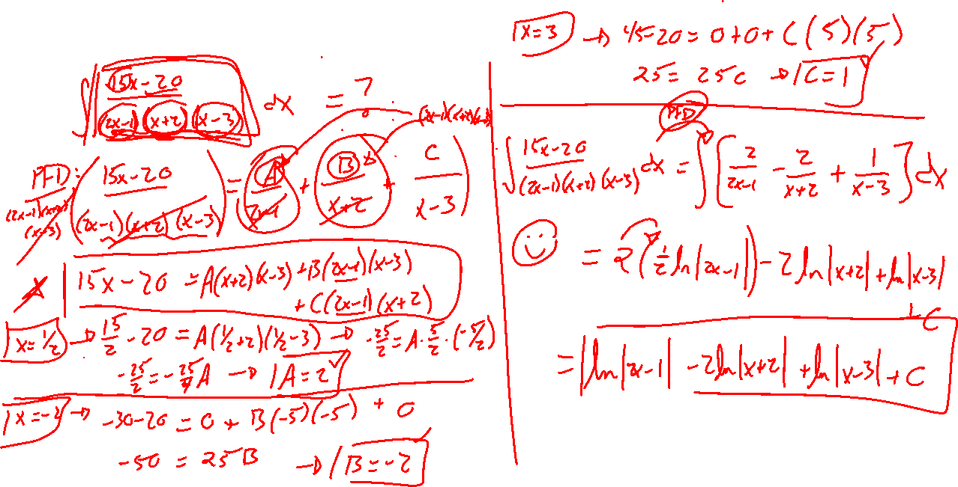
Example: Try on Own
Notes:
(15x-20)/[(2x-1)(x+2)(x-3)]

